Slide 1
Brazilian IFI
An overview of the institution

Slide 2
Foundation
Resolution nº 42/2016 – Federal Senate
Primary legislation
Small institution (currently 8 members + 4 interns)

Slide 3
Mandate Resolution nº 42/2016 of the Federal Senate
Release estimates of parameters and variables relevant for the elaboration of fiscal and budgetary scenarios
Verify if fiscal and budgetary indicators meet legal targets
Evaluate the impact of relevant fiscal events, including the costs of monetary, credit and exchange rate policies
Forecast variables relevant for the long term sustainability of the public sector

Slide 4
Organizational chart
José Roberto Afonso
Yoshiaki Nakano
Gustavo Loyola
Fabiana Rocha
Felipe Salto
Advisory Panel
Administrative affairs
Fiscal analysis
Macroeconomic analysis
Policy analysis
Communication
Board of Directors
Marcus Pestana (pres. of Senate)
Vilma Pinto (Econ. Affairs Comm.)
Alexandre Andrade (Transparency Comm.)
Thuane Rocha
Lucas Leal (intern)
vacancy (Coord.)
Marcio Fernandes (intern)
Gabriela Mello (intern)
Alexandre Andrade (Coord.)
Eduardo Nogueira
Rafael Bacciotti (Coord.)
Pedro Henrique
Alessandro Casalecchi (Coord.)
Bruna Araújo (intern)

Slide 5
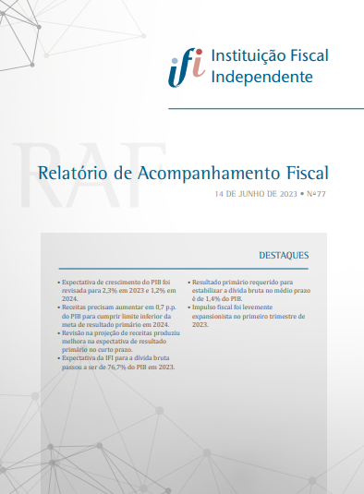
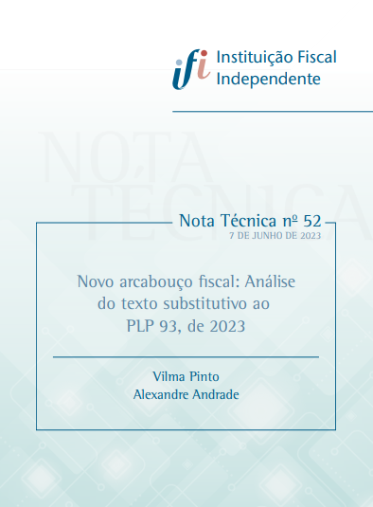
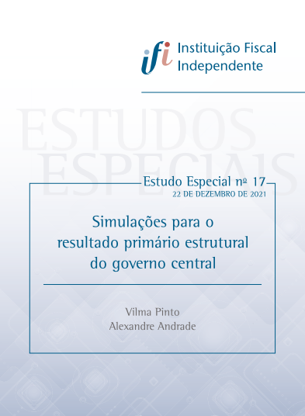
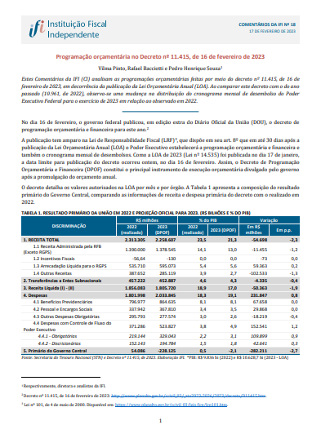
Publications
Fiscal Follow-Up Report
Medium-sized document.
Flagship monthly report.
Macroeconomics, revenues, expenditures, budget, fiscal rules, etc.
Medium-term forecasts updated twice a year.
Technical Notes
Short document.
Specific policy analysis, impact estimates of selected events, methodological expositions.
Special studies Long document.
Compreehensive policy analysis, impact estimates of reforms, methodological expositions, etc.
Position papers
Short document.
Fast response of the Board of Directors to specific fiscal measures, just after announcement/release.

Slide 6
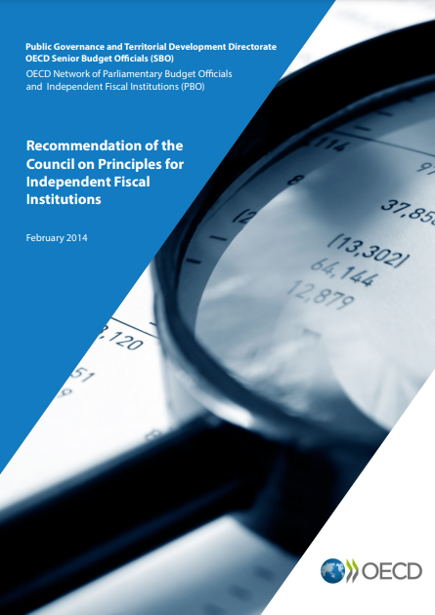
Dissemination of results
OECD’s Recommendation of the Council on Principles for Independent Fiscal Institutions
8. Communications
8.1 IFIs should develop effective communication channels from the outset, especially with the media, civil society, and other stakeholders. Given that the influence of IFIs in fiscal policy making is persuasive (rather than coercive by means of legal sanctions or other punitive measures), media coverage of their work assists in fostering informed constituencies that may then exercise timely pressure on the government to behave transparently and responsibly in fiscal matters.

Slide 7
Dissemination of results
Press service
Online data repository
Participation in public hearings
Social networks (Twitter, Instagram, YouTube, LinkedIn, Facebook, GitHub)
Meetings with other government departments (Central Bank, National Treasury, National Court of Accounts, Ministry of Planning and Budget, etc.)
Meetings with other IFIs (eg Portugal, South Africa, OECD Meetings)
Meetings with the financial market (banks, asset managers, rating agencies)
Meetings with international organizations (OECD, IMF, WB, IDB, CEPAL, etc.)
Meeting with Members of Parliament (eg about new fiscal framework)
Participation in academic seminars (national and international)

Slide 8
Media visibility
The press is important to assess IFIs' performances, since these institutions only have the power to produce information, being unable to impose sanctions
Between 2017 and 2022, the average number of daily mentions in the national press was 1.7 (2019, 2020, 2021 and 2023 were atypical years)

Slide 9
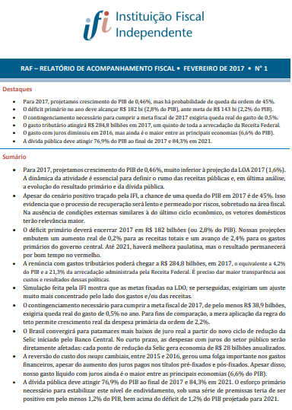
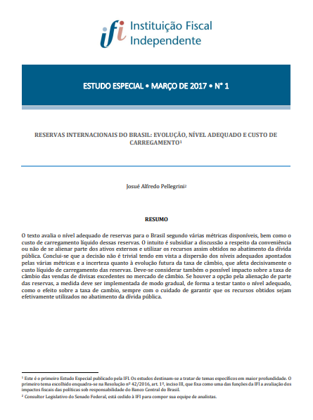
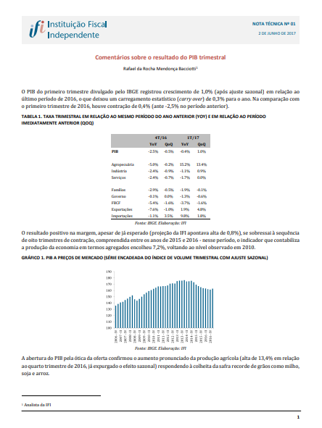
Timeline (1 of 3)
End of 2017
Nov 2016
Feb 2017
Mar 2017
Jun 2017
IFI is created within the Federal Senate
First edition of Fiscal Follow-Up Report series is published
First edition of Special Studies series is published
First edition of Technical Note seres is published
Theme: quarterly GDP
IFI’s analyst is awarded the National Treasury Prize
Theme: cost of foreign exchange reserves

Slide 10
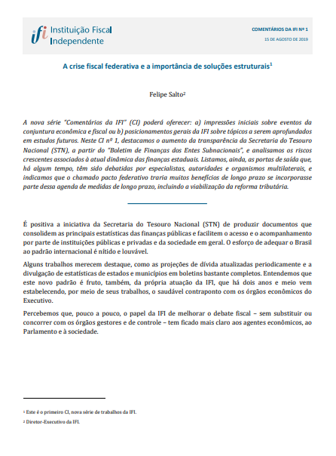
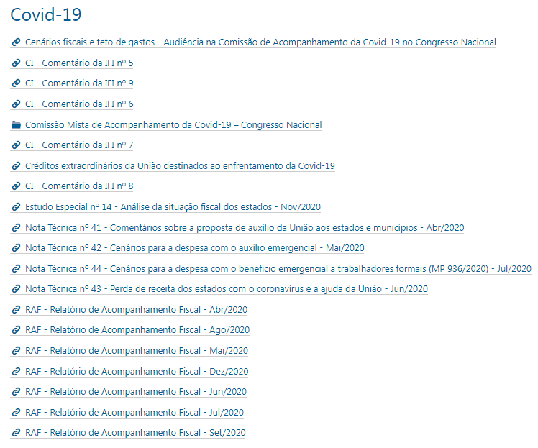
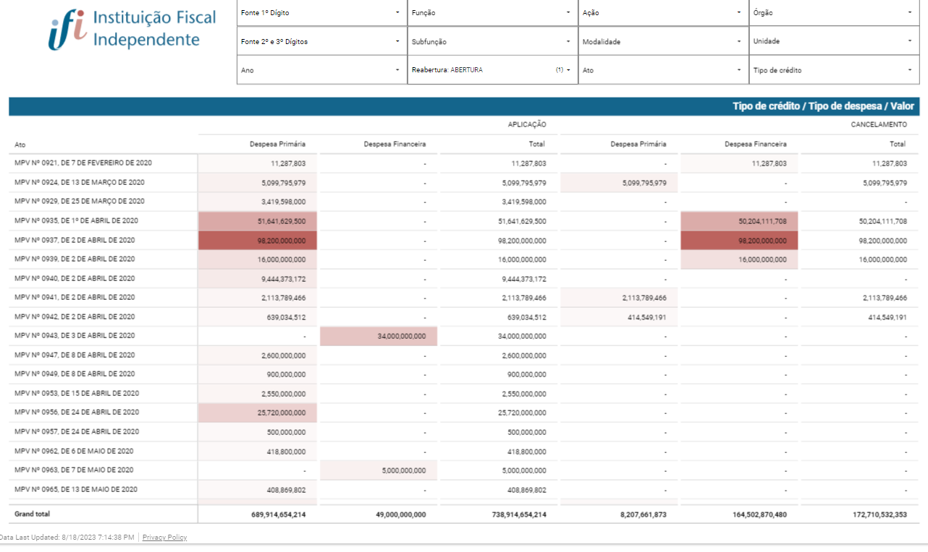
Timeline (2 of 3)
1st semester 2019
End of 2019
Aug 2019
Mar 2020
Many publications on the Social Security Reform
The main financial newspaper publicly greets the IFI for pioneerly bringing estimates to the debate
First edition of Position Paper series is published
IFI’s team is awarded the National Treasury Prize
Theme: pension of public servants
Covid-19 pandemic outbreak. IFI creates a specific, repository within its website, to store the many publications on the theme
An interactive panel is also created, with data of the government’s extra spending measures

Slide 11
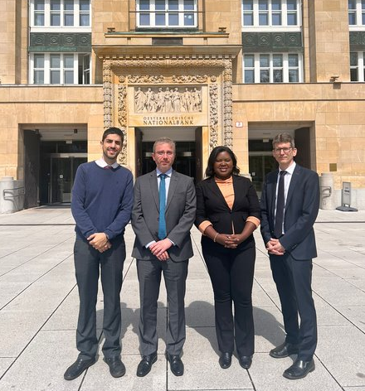
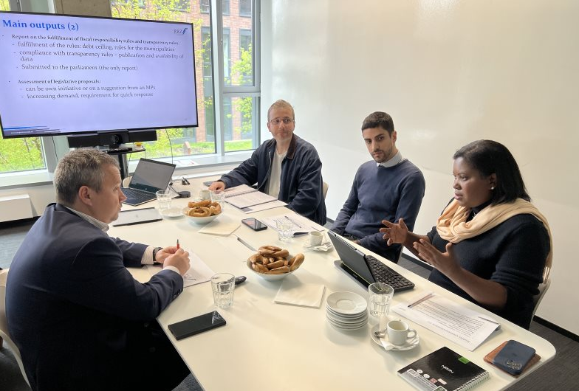
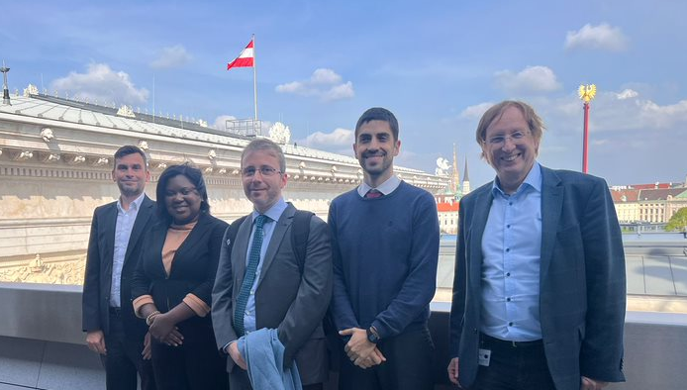
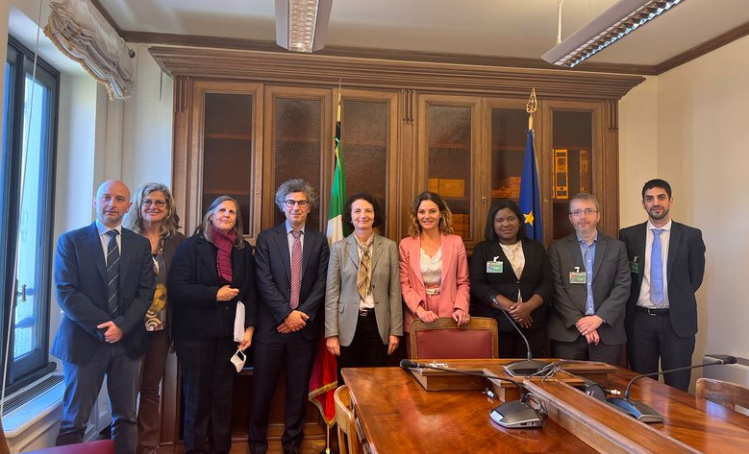
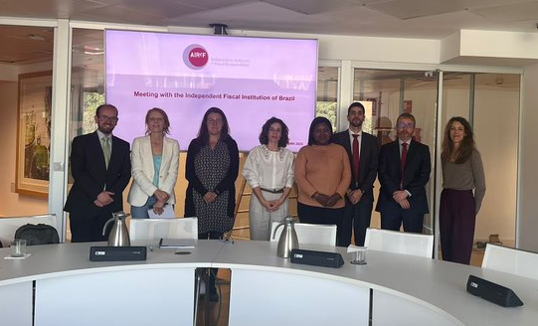
Timeline (3 of 3)
End of 2021
Mar 2021
Apr 2023
Central Bank’s quarterly Inflation Report begins to consistently cite IFI’s analyses
Another IFI’s analyst is awarded the National Treasury Prize
Theme: payroll reform
Brazilian IFI mission visits 4 European IFIs and ECFIN
Austria, Slovakia, Italy, Spain and ECFIN (Brussels)

Slide 12
Ongoing projects
Stochastic simulations for debt (DSA – Debt Sustainability Analysis)
Health system expenditures
Central government investments
Estimation of reference tax rate of the new VAT (Tax Reform)

Slide 13
Final remarks
Initial years reveal a positive balance
Challenges:
Further develop budget and personnel structures
Maintain and improve quality
Broaden the scope of topics (eg more state level analyses)

Slide 14
Thank you!

