Slide 1
IFI/Brazil: performance and challenges

Slide 2
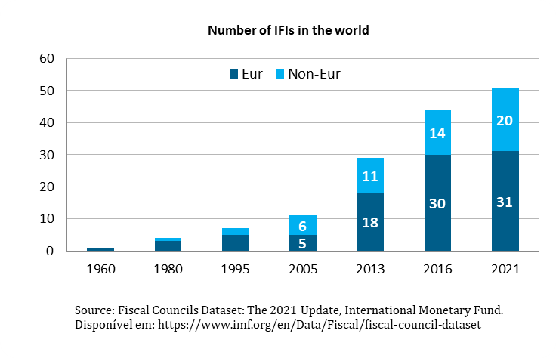
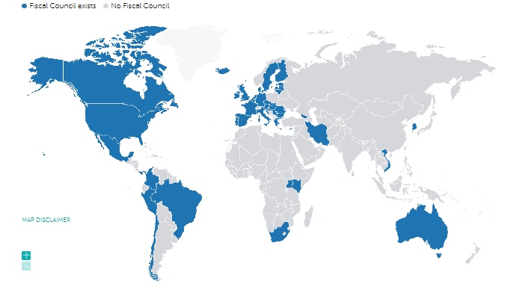
IFIs in the world
IFIs are non-partisan bodies with a mandate to carry out technical and non-partisan analysis on fiscal and budgetary policy to promote greater transparency of the budget and public accounts

Slide 3
Brazil
In Brazil, the creation of the IFI occurred in 2016, through Resolution 42 of the Federal Senate, with the functions of:
- Estimate and release relevant variables for fiscal and budgetary scenarios
- Analyze the adherence of fiscal indicators performance to targets
- Measure the impact of relevant fiscal events
- Forecast fiscal variables that are determinant to the long-term stability of the public sector

Slide 4
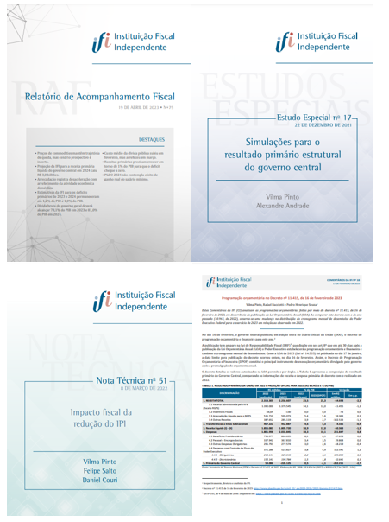
Publications

Slide 5
Others activities
Press service
Data repository
Participation in public hearings
Social networks
Meetings with public agencies
Meetings with the financial market
Meetings with International Organizations
Meeting with Parliamentarians
Participation in Academic Seminars

Slide 6
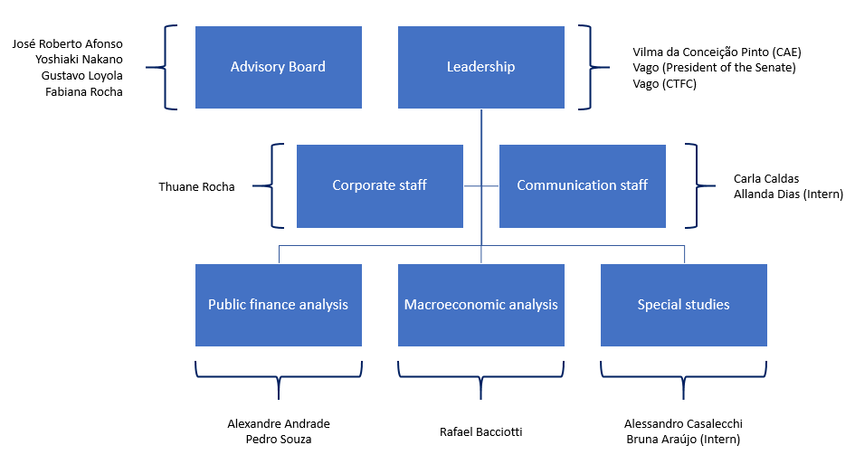
Organizational chart

